Slide 1
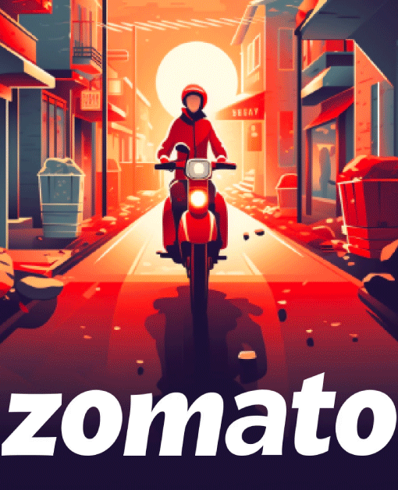
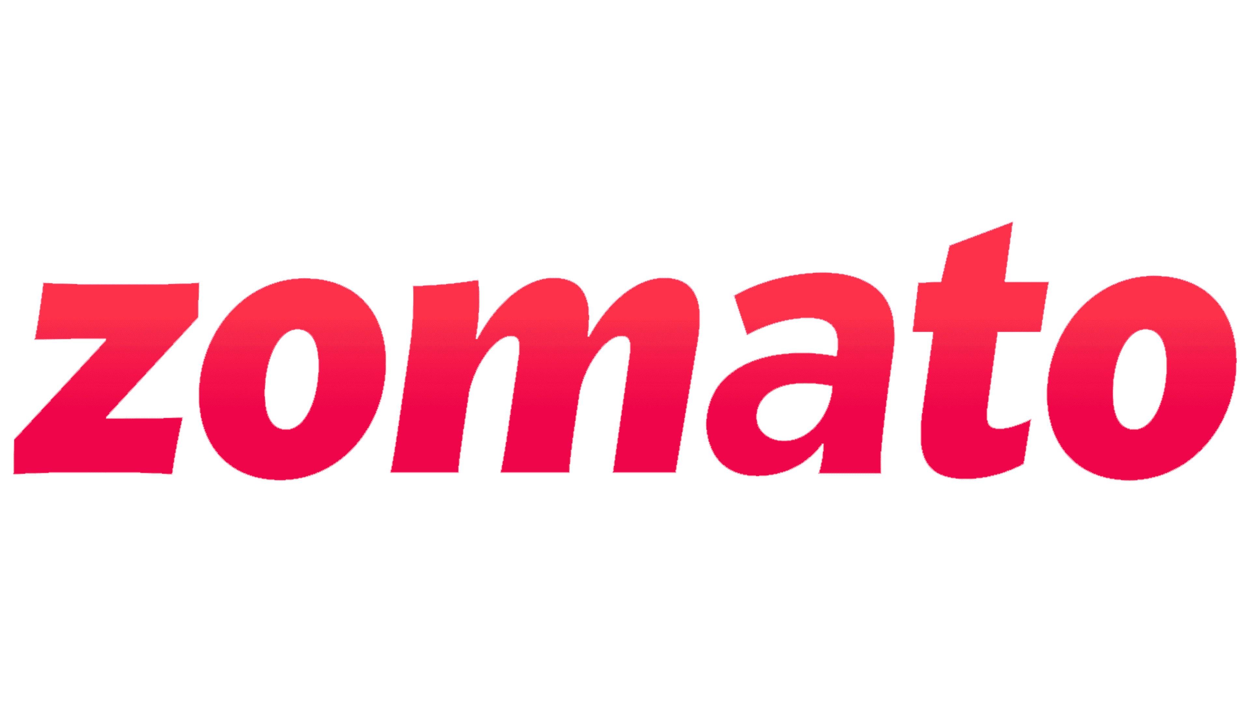
ZOMATO DATA ANALYSIS
CREATED BY: SHUBHAM UPADHYAY
PROJECT FILE: ZOMATO DATA ANALYSIS

Slide 2
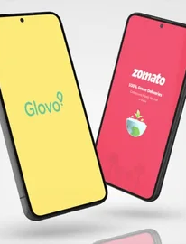
OBJECTIVE
SUMMARIZE THE SALES DATA FORM ZOMATO
Develop a comprehensive visualisation based on the provided dataset. In addition to the visual representation, analyse the sales data to summarise key trends, patterns, and insights. Focus on identifying significant metrics that highlight sales performance, such as total revenue, sales growth, and customer demographics, to provide a clearer understanding of the overall sales environment.

Slide 3
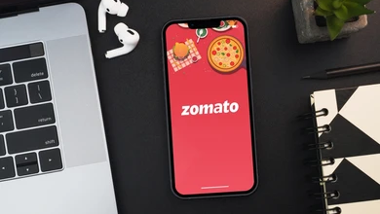
KEY QUESTIONS
1. What Type Of Restaurant Do The majority of customers order from?
2. How many votes has each type of restaurant received from customers?
3. What are the ratings that the majority of restaurants have received?
4. Zomato has observed that most couples order most of their food online. What is their average spending on each order?
5. Which mode (online or offline) has received the maximum rating?
6. Which type of restaurant received more offline orders, so that zomato can provide customers with some good offers?

Slide 4
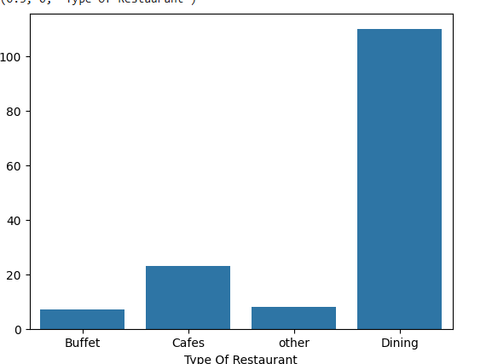
1. What Type Of Restaurant Do The majority of customers order from?
Key Observations:
* Dining Restaurants: The bar for "Dining" is significantly taller than the others, indicating that it receives the highest number of orders. This suggests that most customers prefer to dine in restaurants rather than other options.
* Other Restaurant Types: The bars for "Buffet," "Cafes," and "Other" are relatively shorter, implying that they receive fewer orders compared to "Dining." This suggests that a smaller proportion of customers opt for these restaurant types.
In Summary:
The graph demonstrates that "Dining" restaurants are the most popular choice among customers, while "Buffet," "Cafes," and "Other" options are less frequently selected.

Slide 5
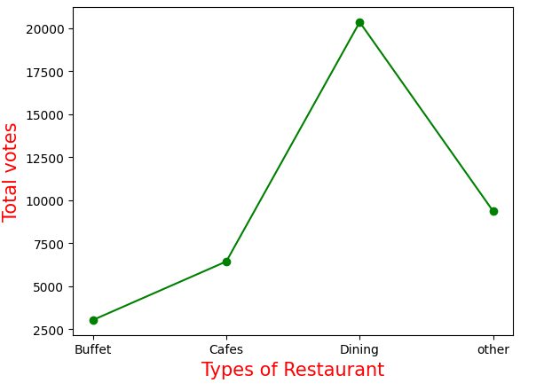
2. How many votes has each type of restaurant received from customers?
Key Observations:
* Dining Restaurants:
The bar for "Dining" is significantly taller than the others, indicating that it has received the highest number of votes. This suggests that it is the most preferred type of restaurant among customers.
* Other Restaurant Types:
The bars for "Buffet," "Cafes," and "Other" are relatively shorter, implying that they have received fewer votes compared to "Dining." This suggests that a smaller proportion of customers prefer these restaurant types.
In Summary:
The graph demonstrates that "Dining" restaurants are the most popular choice among customers, while "Buffet," "Cafes," and "Other" options are less frequently chosen.

Slide 6
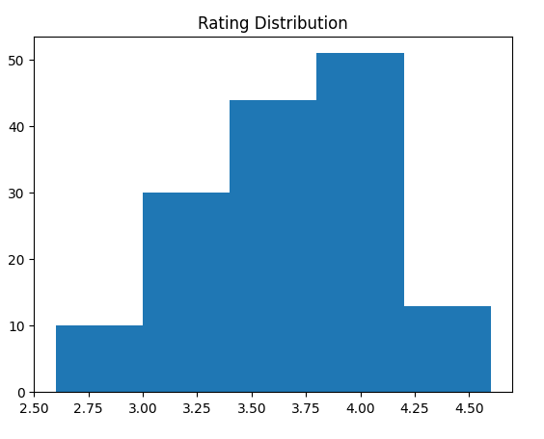
3. What are the ratings that the majority of restaurants have received?
Key Observations:
* Majority of Ratings: The bars between 3.75 and 4.50 are taller than the others, indicating that a majority of restaurants have received ratings within this range. This suggests that a large proportion of restaurants are rated highly by customers.
* Lower Ratings: The bars for ratings below 3.75 are shorter, implying that fewer restaurants have received lower ratings. This suggests that a smaller proportion of restaurants are rated poorly by customers.
In Summary:
The graph demonstrates that the majority of restaurants have received ratings between 3.75 and 4.50, indicating that they are generally well-regarded by customers.

Slide 7
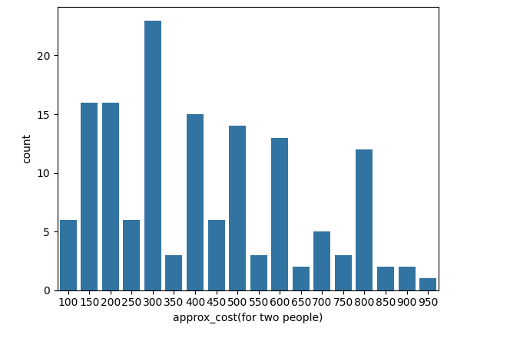
4. Zomato has observed that most couples order their food online. What is their average spending on each order?
Key Observations:
* Most Common Spending Range:
The tallest bars are between 150 and 300, indicating that the most common spending range for couples ordering food online is within this range. This suggests that a majority of couples spend between 150 and 300 per order.
* Other Spending Ranges:
There are also bars for other spending ranges, such as 100-150, 300-350, and 400-450, but they are shorter than the 150-300 bar. This suggests that a smaller proportion of couples spend within these ranges.
In Summary:
The graph demonstrates that the average spending on each order for couples ordering food online through Zomato is likely to be around 225, falling within the most common spending range of 150-300.

Slide 8
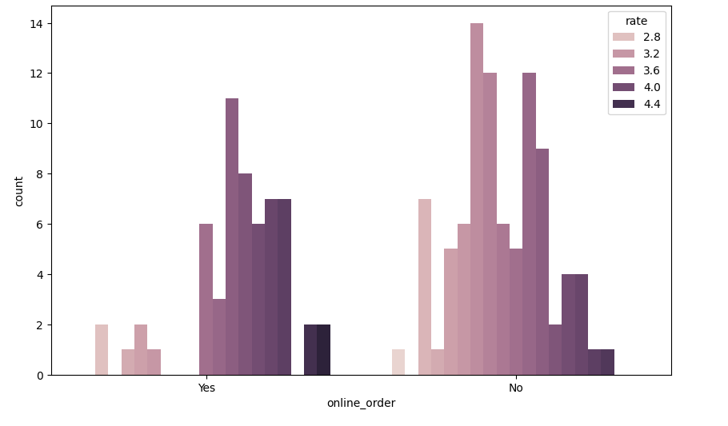
5. Which mode (online or offline) has received the maximum rating?
Key Observations:
* Higher Ratings for Online Orders: The bars for online orders are taller than the bars for offline orders for each rating category. This indicates that a higher proportion of online orders received higher ratings compared to offline orders.
* Distribution of Ratings: The distribution of ratings is similar for both online and offline orders, with a majority of orders receiving ratings between 3.2 and 4.4. However, the proportion of online orders in the higher rating categories (3.6 and 4.4) is greater than that of offline orders.
In Summary:
The graph suggests that online orders have received higher ratings overall compared to offline orders. While both modes have a similar distribution of ratings, a larger proportion of online orders fall into the higher rating categories.

Slide 9
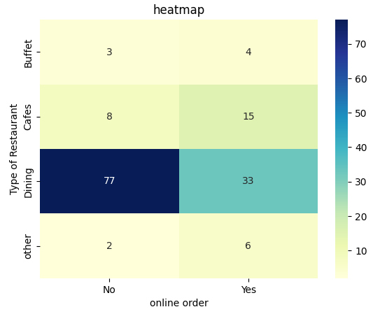
6. Which type of restaurant received more offline orders so that Zomato could offer customers better offers?
Key Observations:
* Dining Restaurants: The cell for "Dining" restaurants and "No" (offline orders) has the highest value (77), indicating that Dining restaurants received the most offline orders. This suggests that Zomato could focus on offering better offers to customers at Dining restaurants.
* Other Restaurant Types: The cells for "Buffet," "Cafes," and "Other" restaurants have lower values for offline orders, suggesting that they received fewer offline orders compared to Dining restaurants.
In Summary:
The heatmap demonstrates that Dining restaurants received the most offline orders. Therefore, Zomato could offer better offers to customers at Dining restaurants to encourage more offline orders.

Slide 10
CONCLUSION
This analysis of Zomato data has provided valuable insights into the Indian food delivery market.
Key findings include:
The dominance of top-rated restaurants and their impact on customer preference
The significance of factors like cuisine, location, and pricing on customer choices
The role of user reviews and ratings in shaping restaurant popularity
These insights can inform business strategies for restaurants and food delivery platforms, ultimately enhancing the dining experience for customers. Future analysis can delve deeper into personalized recommendations, demand forecasting, and market segmentation to uncover more nuanced trends and opportunities.

Slide 11
THANK YOU

